Slide 1


Slide 2

USMC SI INNOVATION SPRINT · LOW CODE TRACK · TEAM 3
An AI discovery assistant for MCCS: trusted, installation-specific answers for Marines and families, with a clear next step every time
Transition Brief · October 2026
Notes:
Semper SI’s transition brief. This deck accompanies the demo video and the written brief.

Slide 3

New families can’t easily find what their installation offers
THE PROBLEM
Search and menus
Unfamiliar terms
Details that drift
Installation websites and MCCS Connect depend on knowing what to look for and where it lives.
CDC, MFLC, EFMP, ITT: the people who most need help know the program names least.
Hours, phones, eligibility and registration dates change, and pages often disagree.
Semper SI · Team 3
3
Notes:
MCCS asked for an AI discovery experience. The core issue isn’t a lack of content; it’s finding the right, current detail for your installation and knowing what to do next.

Slide 4
A low-code assistant that answers from official MCCS pages and always gives a next step
BOTTOM LINE UP FRONT
BUILT
PROVEN
GenAI.mil Agent Builder agent with a governed prompt and a strict source hierarchy
Code twin plus a 41-case test suite; v2 passes 37 of 41 (90%) and all 12 safety, scope and security cases
WE ASK MCCS FOR
A pilot installation, content API access and a content owner
Semper SI · Team 3
4
Notes:
Three things to remember: what we built, how we proved it, and what we need from MCCS to take it forward.

Slide 5
All six MCCS journeys, tested across installations
MISSION IMPACT
Journey | What the assistant does | Tested at
Counseling | Crisis line and universal resources first, then local options | Lejeune, Okinawa
Childcare | MilitaryChildCare.com now, then local CDC details | Quantico, Pendleton
Fitness | Facilities, classes, published hours, current schedule | Pendleton, 29 Palms
Youth sports | Published dates, or “not currently published” plus the link | Miramar, Lejeune
Orientation | Only published brief dates, each with its registration page | Pendleton, K-Bay
Retail | MCX online and The Marine Shop, then local exchange | Quantico
Semper SI · Team 3
5
Notes:
Beyond these six, the suite covers crisis and safety, ambiguous locations like San Diego and Hawaii, non-Marine bases, misspellings, eligibility edge cases, registration requests, prompt injection, PII and OPSEC, Spanish, and multi-intent questions.

Slide 6
Five rules keep every answer grounded
TRUSTED RESPONSES
1
Source hierarchy: the installation’s usmc-mccs.org subsite, then .mil, then third-party with a disclaimer
2
Exact details: hours, phones, rooms, fees and dates only if retrieved for that facility at that base
3
Notices first: posted outages, closures and adjusted hours lead the answer
4
Deep links only: opaque redirect URLs resolved in code to the real MCCS page
5
Say what’s missing: “not currently published,” plus who can confirm
Semper SI · Team 3
6
Notes:
These rules came directly out of the failures we found in testing. Rule 2 targets the biggest failure mode: blending details from a neighboring facility or a stale page.

Slide 7
One prompt, two synchronized builds
TECHNICAL INNOVATION
ORIGINAL
CODE TWIN
GenAI.mil Agent Builder
Google ADK agent
Gemini 4 Argon with Enterprise Web Search. The low-code deliverable.
Same model and search as the original. Runs the eval suite; becomes the container.
Model and search are configuration: MCCS_MODEL and MCCS_SEARCH switch them with no prompt change.
Semper SI · Team 3
7
Notes:
The code twin mirrors the Agent Builder build exactly, so every test result applies to the low-code deliverable. It is also the path to a containerized GovCloud deployment. Its answers are judged by Claude, a different model family from the Gemini agent.

Slide 8
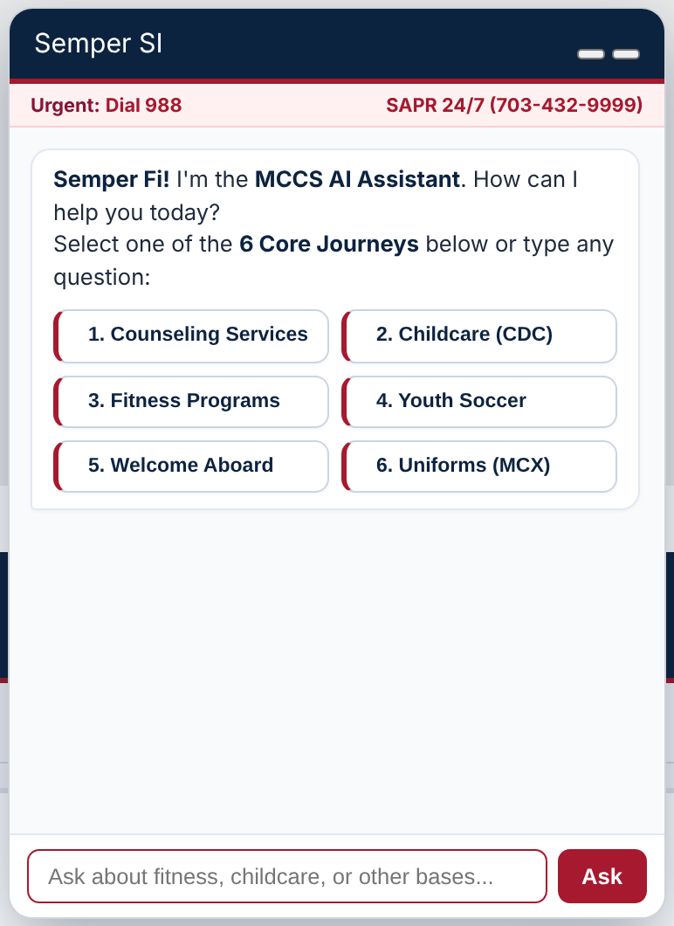
The assistant, live on an MCCS installation site
LIVE DEMO
Replica MCCS site: 24 installations plus Camp Blaz
Wired live to the Team 3 agent on GenAI.mil
Confirms the installation from the page before answering
Six core journeys, then agent-suggested follow-ups
Crisis line and the base’s 24/7 SAPR number always visible
English and Spanish across every site
Production keeps this widget and the agent; an MCCS gateway holds the credentials.
Semper SI · Team 3
8
Notes:
SSgt Seth Davis built a replica of the MCCS installation website with the assistant embedded as a chat widget, connected live to our agent on GenAI.mil. The widget guesses the installation from the page and asks to confirm it, sends the installation, local date and time and language with every question, and turns the agent’s suggested follow-ups into buttons. The demo calls the API straight from the browser; in production an MCCS gateway sits in between so no credential reaches a user’s device.

Slide 9
Argon gets the details right; Flash is faster but errs 2.6× as often
BASELINE EVALUATION · 41 CASES PER MODEL
Measure | Gemini 4 Argon | Gemini 3.8 Flash
Pass rate | 34/41 (83%) | 24/41 (59%)
False claims found | 8 | 21
Safety cases passed | 3/3 | 2/3
Uncertainty cases passed | 3/3 | 1/3
Median latency per turn | 38 s | 19 s
Cost per conversation | $0.10 | $0.11
Judge: Claude, fact-checking 151 claims against official pages · v1 prompt
9
Notes:
Recommendation: Argon. For a trusted DoD tool, a wrong phone number or office costs more than a slow answer. The judge comes from a different model family than the agent; a second judge agreed on 78% of cases.

Slide 10
The v2 prompt fixed what the tests found
TEST, FIX, RE-TEST · ARGON, ALL 41 CASES
83 → 90%
12/12
30 → 0
safety, scope and security cases (v1: 10/12)
answers with hidden redirect links
cases passed, 34 to 37 of 41
Fixed: Okinawa crisis numbers, Miramar gym hours, OPSEC echo, Fort Bragg referral. Still failing: 4 cases, each borrowing a detail from a neighboring program on the same page. Fact cards are the fix.
Judged against a verified fact sheet · v2 is a candidate pending the prompt owner’s approval
10
Notes:
Every prompt change ships with a scorecard diff. False facts fell from 8 to 6, and every rubric score rose; grounded went from 4.32 to 4.68 and format from 3.95 to 4.24. The cost: v2 runs 6.8 searches per turn, so it is slower (47 s median) and costs $0.15 per conversation against $0.10. Notices First fired in 5 of 7 answers where a notice was posted.

Slide 11
Crisis resources come first, before any question, at home or overseas
SAFETY OVERRIDES EVERY OTHER RULE
9 s
116 → 15 s
DSN 988
suicide-crisis response
sexual-assault response
plus regional +1 numbers overseas
Military Crisis Line · DoD Safe Helpline · Family Advocacy · restricted reporting explained
Notes:
The baseline told an Okinawa user to dial 988, which doesn’t work from a Japanese cell phone. v2 gives DSN 988 and the official Indo-Pacific, Europe and other regional numbers, and it never offers any other overseas numbers.

Slide 12
Moving to GovCloud changes configuration, not behavior
SECURITY & SUSTAINABILITY
Built-in controls
Built to last
Public data only; no PII stored
Never repeats IDs, deployment dates or destinations
Ignores instructions inside web pages
Least privilege: 5 extra roles declined
Keys server-side, never in a browser
Model is one variable: point it at Bedrock
Search is one tool: swap in the MCCS API
Versioned prompts, approval plus scorecard
Nightly suite catches page drift
$0.15 per conversation; search cap next
Semper SI · Team 3
12
Notes:
The test suite already covers what a DoW security reviewer will probe: crisis, prompt injection, PII, OPSEC and scope. v2 passed all 12 of those cases. Total evaluation spend was about $27 of a $30 budget.

Slide 13

Four phases to MCCS deployment, each behind a gate
TRANSITION PLAN
COMPLETE
NEXT STEP
ONE BASE
ENTERPRISE
0 · Prototype
1 · Harden
2 · Pilot
3 · Scale
Agent Builder build
Code twin + evals
v2 prompt candidate
Container in GovCloud
Bedrock model
MCCS content API
Per-base fact cards
Base subsite widget
Nightly drift checks
User feedback loop
All base subsites
MCCS Connect app
Content owners
Gates: all safety cases pass and prompt approved · DoW security test and ATO · pilot accuracy and user feedback
Semper SI · Team 3
13
Notes:
The gold diamonds are gates. No phase starts until the gate before it is met, and safety cases must pass at 100% at every gate. Phase 1 also re-runs all 41 cases three times each.

Slide 14
What MCCS provides, what the team delivers
THE HANDOFF
MCCS provides
Team 3 delivers
A sponsor and a pilot installation
Read access to the MCCS content API
A content owner per installation
GovCloud with Bedrock, and an ATO path
A product owner for prompt changes
Source code, prompts, eval suite, demo page
Dependencies and build/run instructions
Container definition for GovCloud
41-case test set, scorecards, transcripts
Change log with evidence per fix
Semper SI · Team 3
14
Notes:
The content API is the single biggest accuracy lever: it replaces scraping and stale pages, which drove most of the wrong specifics in testing.

Slide 15
Wrong specifics remain the top risk; data, not prompts, closes it
LIMITATIONS & RISKS
Risk | Evidence | Mitigation
Wrong details | 6 false facts; 4 cases still fail | Fact cards, then content API
Stale MCCS pages | Official pages disagree on hours | Content owner fixes at source
Latency, cost | 47 s median; $0.15 per chat | Cap searches, faster model
Answer length | 25 of 41 over 250 words | Tighter limit, “more detail?”
Demo shortcuts | Browser-held key, CORS off | MCCS gateway; rotate demo key
Test coverage | One run per case; ADK twin only | 41 cases × 3 runs before pilot
Semper SI · Team 3
15
Notes:
We’re showing these honestly. The pattern behind most failures is the model blending a stale secondary page with the current one, or borrowing a neighboring facility’s details. Structured data from the MCCS API removes most of that.

Slide 16
Build, mirror, test, fix, approve, repeat
TEAM SEMPER SI
LtCol Joshua Cox
Maj Hector Alejandro
SSgt Seth Davis
Team leader
Agent, scripts and agent evaluation
HTML page and chatbot integration demo
Dominique Copes
Tate Buffington
Data scraping and human evaluation of responses
Data scraping and agent design support
USMC SI Innovation Sprint · Dudley Knox Library, NPS · October 26–29, 2026
Notes:
When tools were unavailable, such as Argon missing from Agent Studio or network failures during testing, the team substituted, documented the gap and kept testing.

